Slide 1
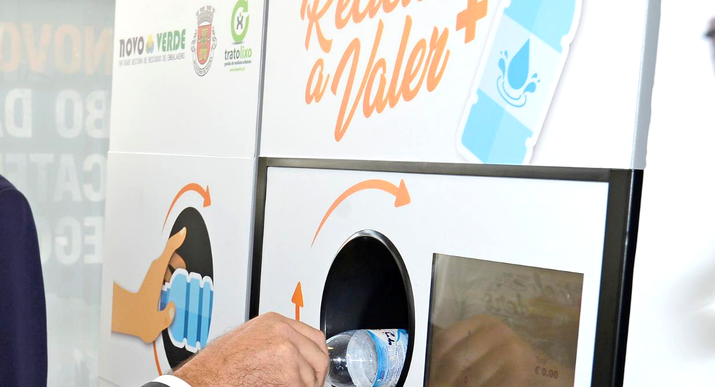

Mafra Reciclar a Valer +
Câmara Municipal de Mafra
MAFRA Reciclar a valer +
30/06/2020

Slide 2

Context
Traditional packaging waste collection systems, including kerbside collection and bring-systems, have the inconvenience to mix different types of materials.
In the case of plastic packaging, the mix of different polymers (such as PET, HDPE, film, PP and PVC) inevitably leads to contamination, material losses and, ultimately, limits the quality of the recovered materials
In the case of aluminium packaging, contamination leads to higher sorting costs when compared to a single material waste stream
It is also established that in order to increase recycling rates it is necessary to give tangible incentives to citizens that separate waste and contribute to recycling efforts
One solution is the use of deposit refund schemes supported by reverse vending machines, which enable the separation of packaging by type of material and simultaneously return some sort of incentive to users.

Slide 3
Objectives
The project Mafra Reciclar a Valer + aims to create a living lab of deposit return schemes to support:
Testing
of different technologies and approaches to DRS
Monitoring
of the DRS implementation and use to gather insights for scale-up
Optimizing
of the DPS’ effectiveness and economic efficiency

Slide 4
Objetives
To meet its objectives, the project will entail several elements:
Testing
Monitoring
Optimizing
Different typologies of DRS equipment, in order to indentify the most adequate for diferente locations and users
Sensing and AI technologies to gather important information on the effectiveness and efficiency of the system
Platform to monitor the network of equipment in real time, with automatic management of collection operations

Slide 5






Partners
Municipality of Mafra aims to support the project to continue the environmental commitment it has assumed with its citizens. The Municipality was a pioneer in the development of the initiative that allowed the placement in 2019 of a plastic beverage packaging deposit machine.
Tratolixo is the regional municipal waste management company covering the municipalities of Cascais, Mafra, Oeiras and Sintra, for a total of more than 800,000 inhabitants. It will be responsible for sorting and handling the waste collected from the DRS machines.
Novo Verde is a producer responsibility organization for packaging waste. In 2019, Novo Verde partnered with the Municipality of Mafra to establish its own collection system with a DRS machine. In this project, Novo Verde aims to expand this system and better understand how these can be implemented.
Electrão is also a producer responsibility organization for packaging waste. In this project, Electrão aims to test and implement different DRS machines and improve its understanding of how these could improve packaging waste management in Portugal.
Instituto Superior Técnico will participate in this project through IN+, a research center with extensive experience in the design of waste management systems and waste-related public policies. In this project, Técnico will help to establish a research framework for continuous improvement of the chosen technologies.
3drivers is an environmental consulting company specialized in waste management and the circular economy. For this project, 3drivers will help to communicate and disseminate results, as well as determining the environmental and economic impacts of these systems in Portugal.

Slide 6
Description of activities
Mafra Reciclar a Valer + project is organized into five main activities:
A 1. Development of system specifications
A 2. System implementation
A 3. System operationalization
A 4. Monitoring and follow-up
A 5. Awareness and dissemination

Slide 7
Description of activities
Mafra Reciclar a Valer + project is organized into five main activities:
A 1. Development of system specifications
Development of the conceptual and functional model of the smart incentive system for beverage packaging
Definition of use cases, equipment, technological architecture and test plan to be developed, which will involve the implementation, operationalization and monitoring activities
Development of the smart system specifications, based on the conceptual model, namely those related to the characteristics of the sorting equipment
A 2. System implementation
A 3. System operationalization
A 4. Monitoring and follow-up
A 5. Awareness and dissemination

Slide 8
Description of activities
Mafra Reciclar a Valer + project is organized into five main activities:
A 1. Development of system specifications
A 2. System implementation
Selection and purchase of 12 DRS machines
Preparation of the locations where the DRS machines will be installed, including stores, markets and public service areas
Training phase of equipment identification systems, in particular to explore the sorting capabilities of non-returnable packaging, by material, reusable packaging and packaging containing secondary raw materials
A 3. System operationalization
A 4. Monitoring and follow-up
A 5. Awareness and dissemination

Slide 9
Description of activities
Mafra Reciclar a Valer + project is organized into five main activities:
A 1. Development of system specifications
A 2. System implementation
A 3. System operationalization
Use phase of the incentive system, including maintenance and technical verification of the equipment
Collection and transport of packages to Tratolixo's sorting facilities, for sorting and preparation of the materials with higher degree of purity and maximizing the return for recycling
Carrying out the auctions within the scope of SIGRE for the recovery of materials and economic recovery. In the case of reusable packaging, proper procedures will be developed, as well as for packaging with secondary raw materials, which will be sought to be valued in a closed circuit.
A 4. Monitoring and follow-up
A 5. Awareness and dissemination

Slide 10
Description of activities
Mafra Reciclar a Valer + project is organized into five main activities:
A 1. Development of system specifications
A 2. System implementation
A 3. System operationalization
A 4. Monitoring and follow-up
Continuous monitoring of the quantities and types of packaging delivered, testing the different monitoring technologies
Assessment of the performance levels of each location and identification of problems and aspects to be improved (such as equipment location, visibility to consumers, incentive values and consumer sensitivity to them), allowing action to be taken to correct and improve
Characterization of packaging lots in the sorting facilities, quantifying by location, type of packaging and contamination. Determination of purity levels, non-returnable packaging, reusable packaging and packaging with secondary raw materials
A 5. Awareness and dissemination

Slide 11
Description of activities
Mafra Reciclar a Valer + project is organized into five main activities:
A 1. Development of system specifications
A 2. System implementation
A 3. System operationalization
A 4. Monitoring and follow-up
A 5. Awareness and dissemination
Dissemination of the project’s results
Raising awareness, promoting stakeholder participation and increasing the geographical scope of the pilot project
Promote the dissemination of knowledge on an open basis, ensuring that it is available to those interested in implementing DRS

Slide 12











Expected results
Mafra Reciclar a Valer +, which will run until December 31, 2021, has the ultimate objective of finding solutions in the design of incentive systems, which allow defining the standard of deposit systems to be adopted starting January 1, 2022
12
Mafra will have 12 locations with packaging deposit equipment
120
120 tons of recycled plastic will be obtained
14 million packages are expected to be collected
45
45 promotion and awareness campaigns in stores, markets, schools and other places with communities
14M

Slide 13
About EEA Grants
Through the Agreement on the European Economic Area (EEA), Iceland, Liechtenstein and Norway are partners in the internal market with the Member States of the European Union.
In order to promote a continuous and balanced strengthening of economic and trade relations, the parties to the EEA Agreement have established a multi-annual Financial Mechanism, known as the EEA Grants.
The EEA Grants aim to reduce social and economic disparities in Europe and to strengthen bilateral relations between these three countries and the recipient countries.
For the 2014-2021 period, a total contribution of € 2.8 billion has been agreed to 15 beneficiary countries. Portugal will benefit from a budget of € 102.7 million.
Learn more at eeagrants.gov.pt

Slide 14







Thank you!
Site: www.eeagrants.gov.pt
Facebook: ww.facebook.com/EEAGrantsPortugal/
Instagram: @eeagrantspt
Youtube: youtube.com/channel/UCXywLHBsmkaGfCniCLyfXsw
Twitter: @EEAGrantsPortugal
Linkdin: EEA Grants Portugal
E-mail: geral@eeagrants.gov.pt | rita.soares@eeagrants.gov.pt
Funded by:
Program operator:
Promoter:
Partners:

