Slide 1




Project Bebidas+ Circulares
PROJETO 10_CALL#1 EEA Grants – Deposit refund system for beverage bottles and cans
30th June 2020

Slide 2


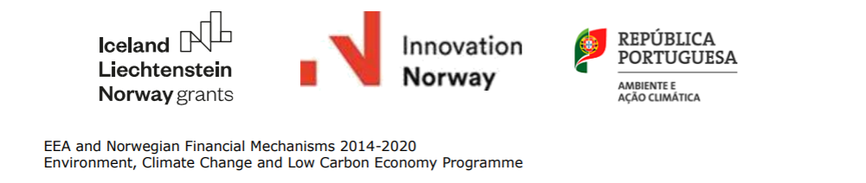



Project "Bebidas+ Circulares” Promoter
Consortium formed by the associations:
Partners with an unique experience at the national level in the design and implementation of a packaging collection system through automatic machines, in particular in the pilot project for the return of plastic beverage bottles promoted by Fundo Ambiental.

Slide 3
Objectives
Implementation of an incentive system with the attribution of a reward to the consumer for the return of non-reusable drinking bottles or cans, contributing to their recycling and production of high quality recycled material, compatible with the incorporation on the production of new beverage packaging, promoting the circularity of the recovered materials
Test a solution based on the collection with automatic machines in a restrict area – municipality with a high population density – Lisboa – evaluating population adherence to this new collecting mechanism

Slide 4
Project "Bebidas+ Circulares” Main characteristics
Localization: Project to be part of the “Lisboa Capital Verde” program, with the collaboration of C.M. Lisboa and Valorsul
Dimension: Installation of 11 machines
Packaging covered: Plastic and Metal drinking packages (+Glass, to be assessed)
Incentive: Attribution of an incentive of equal value to the one defined on the Dispatch 6534/2019, ensuring harmonization and comparability between projects that will take place simultaneously
Project duration: 18 months
Budget: 999,503 € (899,553 € financed by EEA Grants Program)

Slide 5
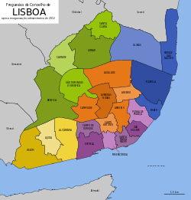
Project "Bebidas+ Circulares” Localization
Project to be implemented in Lisboa: concentration in a municipality, increasing the representativity of the sample and allowing a better monitoring consumer behavior
11 Recovery points (RVM)
Placement of 2 machines in each of the 5 UIT (Territorial Intervention Unit)
Covering different segments of retail trade (including smaller stores) and participatory balance in terms of shopping areas

Slide 6
Project "Bebidas+ Circulares” Incentive
Packing capacity | Prize amount
≤ 0.5 L | 0.02€
> 0.5 L and ≤ 2 L | 0.05€
Award to be attributed through ticket for use in purchases or donations to social institutions

Slide 7
Project "Bebidas+ Circulares” Main project indicators and targets
Indicator | Target
Number of innovative pilot solutions to increase resource efficiency (number) | 11 Installed machines
Packages collected (number) | 2,500,000
Tons of resulting recycled plastic (ton) | 50

Slide 8
Project "Beverages+ Circular" Communication
Project support communication and awareness plan, with the following objectives:
Engage consumers, demonstrating the existence of environmentally friendly solutions for the circularity of packaging and positioning empty bottles as a resource and not as waste;
Inform and clarify the final consumer with the purpose of ensuring the correct routing of the packages and reinforcing their confidence in the future deposit system;
Ensure adequate training of the various players in the system, segmented by players and articulated with associations representing the sector;
Collect relevant information regarding the socio-cultural context of the recovery points, characterization of the participants and their motivations, as well as difficulties and possible complaints.

Slide 9
Project "Beverages+ Circular" Project plan
Activity Description | 2020 |  |  |  |  |  |  |  |  |  |  |  |  | 2021
 | 1 | 2 | 3 | 4 | 5 | 6 | 7 | 8 | 9 | 10 |  | 11 | 12 | 1 | 2 | 3 | 4 | 5 | 6 | 7 | 8 | 9 | 10 |  | 11 | 12
1. Planning and design
1.1 Detailed planning
1.2 Selection of recovery points
1.3 Articulation with other entities
1.4 Market consultations (RVM equipment, communication ...)
2. Implementation
2.1 Machines installation and operation
2.2 Preventive maintenance
2.3 Collection and delivery of packaging
3. Communication
4. Studies
5. Project Monitoring and Report

